Slide 1


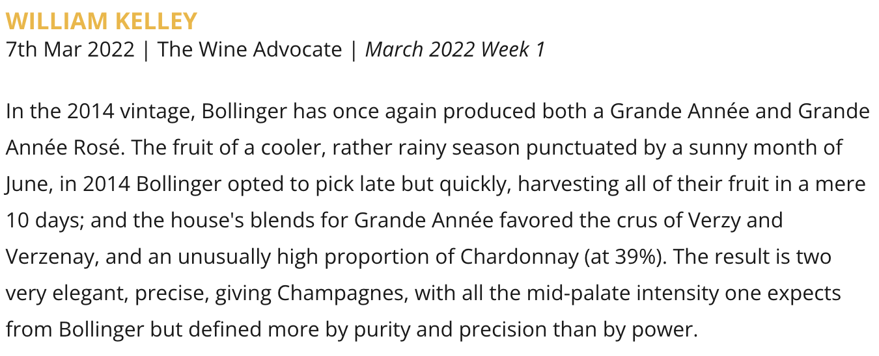

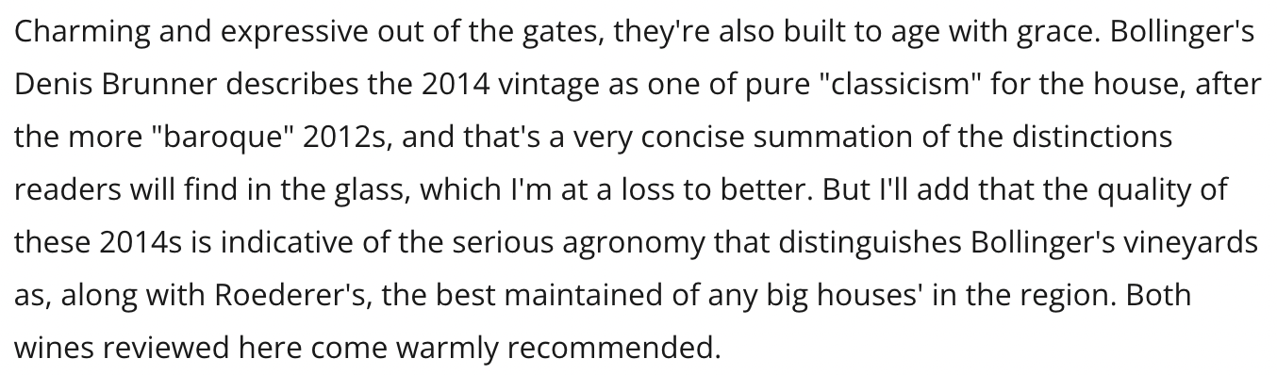

Bollinger | Wine Advocate | March 7, 2022 | UVM: 60.8K+

